Slide 1

Machine Learning Lifecycle Made Easy
with
Karishma Babbar
Kalyan Munjuluri
October 29, 2021

Slide 2
Outline
Background
ML Lifecycle
Development Challenges
Introduction
Overview of MLflow
Components of MLflow
MLflow tackles ML development challenges
Key Concepts
Code-Along
Quickstart
Examples
Conclusion
Recap
Takeaway Exercise

Slide 3
Building machine learning pipeline is hard.

Slide 4
ML Lifecycle
Deploy
Raw Data
Training
Data Prep

Slide 5



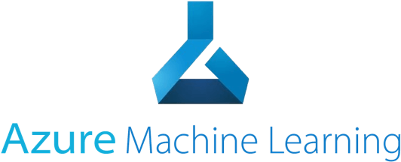












ML Lifecycle
Deploy
Raw Data
Training
Data Prep

Slide 6
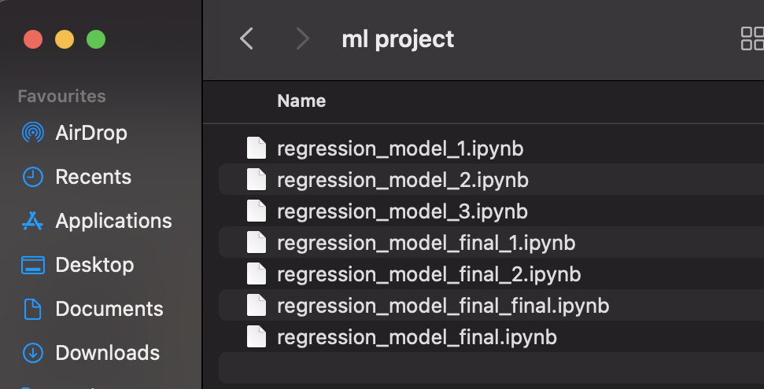

Slide 7
ML Lifecycle
Deploy
Raw Data
Training
Data Prep

Slide 8
Development Challenges
Deploy
Raw Data
File
Batch
Streaming
Integration
Monitoring
Scale
Governance
Training
Data Prep
Multiple Algorithms
Hyperparameter
Model Comparison
Model Evaluation
Data Preprocessing Feature Engineering Data Transformation
Notes:
Diversity and number of ML tools involved
Continuous nature of ML development
Complexity of productionising ML models
Monitoring & Governance

Slide 9
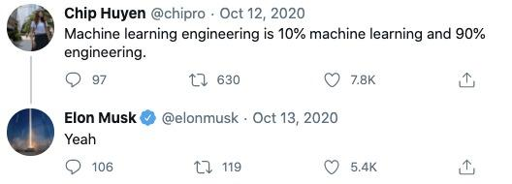

Slide 10
Can we uncomplicate the development of ML pipeline?

Slide 11
Overview of MLflow
Open-source platform for complete ML Lifecycle
Developed by Databricks
Cross-cloud, modular, API-first framework
Open & extensible by design
Platform agnostic for maximum flexibility
Notes:
Compatible with popular ml frameworks and libraries
Provides reproducibility across runs on all platforms
Designed to improve collaboration

Slide 12
Components of MLflow
Tracking
Models
Projects
Record & track experiments: code, data, config, results
General format to serve models on diverse deployment platforms
Packaging models for reproducibility & reusability on any platform

Slide 13
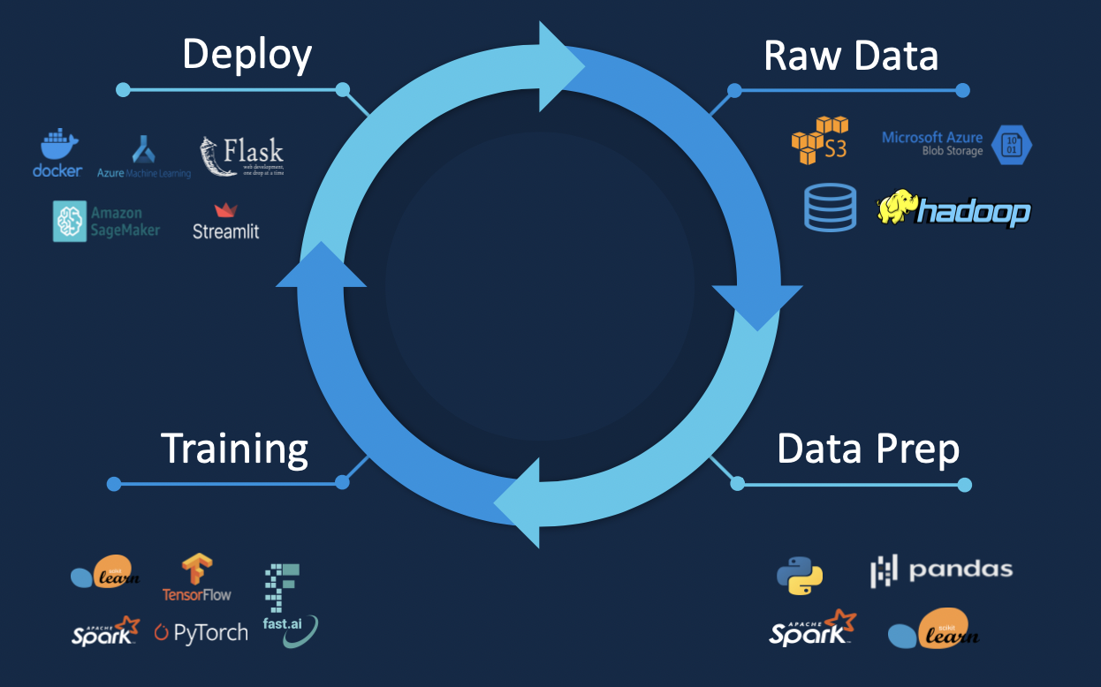
MLflow tackles ML development challenges
Models
Projects
Tracking

Slide 14

Tracking

Slide 15
Key Concepts - MLflow Tracking
Run: Execution of code that can recorded to local files, databases and remote tracking server.
Code Version: Git commit hash used for the run, if it was run from an MLflow Project.
Source: Name of the file to launch the run, or the project name and entry point for the run.
Parameters: Key-value input parameters of your choice. Both keys and values are strings.
Metrics: Key-value metrics, where the value is numeric. Such as model accuracy, precision, recall, etc.
Artifacts: Output files in any format. For instance, plots, pickles, data files, etc.

Slide 16


MLflow Tracking
Notebooks
Tracking API
Tracking
Github
Tracking UI

Slide 17


Recording MLflow Runs
MLflow code + APIs
MLflow code + APIs
Artifacts
FileStore
Artifacts
FileStore
Scenario 1: On local machine
Scenario 2: On local machine
with sqlite database

Slide 18

Recording MLflow Runs
MLflow code
+ APIs
REST
MLflow code
+ APIs
REST
Tracking
Server
Tracking
Server
RestStore
RestStore
FileStore
FileStore
Artifacts
Artifacts
PostgreSQL
Scenario 3: On local machine with a tracking server
Scenario 4: Tracking server, remote backend & storage

Slide 19
demo.py
with mlflow.start_run():
alpha = 0.01
# logging parameters
mlflow.log_param("alpha", alpha)
{ train model and return rmse and r_squared values
On test data }
# logging evaluation metrics
mlflow.log_metric("rmse", rmse)
mlflow.log_metric("r2", r_Squared)
# saving model with sklearn flavor
mlflow.sklearn.log_model(model, "SGDmodel")

Slide 20
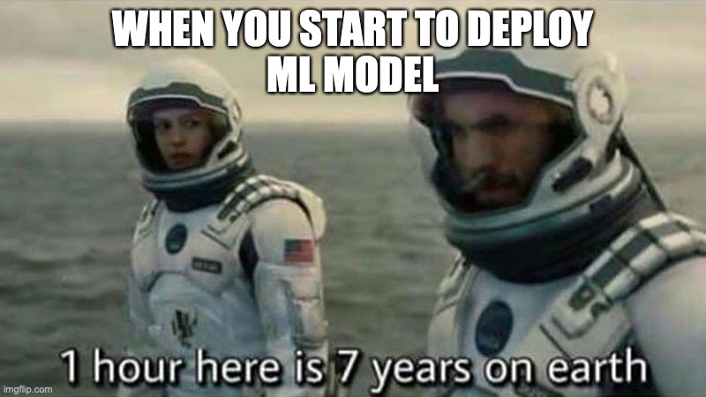
Models

Slide 21
Key Concepts - MLflow Models
Flavors: Modules/frameworks that can interpreted by deployment tools to understand the model without any separate integration mechanism for each tool or library used in the model. Standard flavors provided by MLflow include python_function, sklearn, xgboost, etc.
Model Signature: Defines the schema of the model’s input & output parameters that can either be column-based or tensor-based.
Input Example: Defines an instance of valid model input and stored as separate artifacts.
MLmodel File: A text file in YAML format that outlines multiple flavors the model can be viewed in, model signature and input example.
Notes:
Model signature: Json format, is recognized and enforced, validates the input parameters of the model when executed

Slide 22

MLflow Models
YAML file
Flavor
Model Signature
Input Example
Models
Platform Agnostic

Slide 23
Terminal
mlflow models serve --model-uri mlruns/0/{run_id}/artifacts/{model} -p {port_number}
curl http://127.0.0.1:{port_number}/invocations -H 'Content-Type: application/json' -d '{
"columns": ["x1","x2","x3"],
"data": [[0.0453409833,-0.0446416365,-0.0062059541]] }’

Slide 24
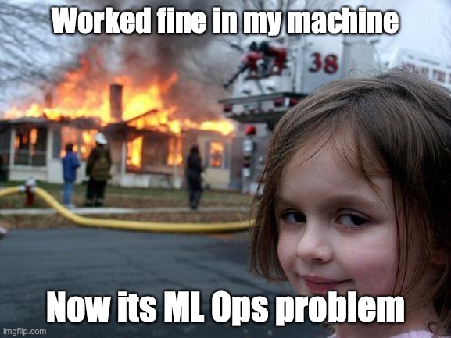
Projects

Slide 25
Key Concepts - MLflow Projects
Project Name: Name of the project.
Entry Point: Invocation of the function, module, command or script that can run within the project, and information about their parameters.
Environment: The software environment that should be used to execute the project. There are 3 environments namely, system/local, conda & docker containers.
MLproject File: A text file in YAML format containing project name, environment as well as more detailed information about each entry point.

Slide 26
MLflow Projects
YAML file
Project name
Entry point
Environment
Local Execution
Projects
Cloud Execution

Slide 27
mlProject.yaml
name: tutorial
conda_env: conda.yaml
entry_points:
main:
parameters:
alpha: {type: float, default: 0.01}
command: "python model.py {alpha}"

Slide 28
Code-Along

Slide 29
Quickstart
# Prerequisites
Python 3
pip install jupyter
pip install pandas
pip install scikit-learn
pip install matplotlib
pip install numpy
# Installation
pip install mlflow
Session notebooks are available at shorturl.at/orwMT
Read the documentation here and code examples provided by MLflow here

Slide 30
Conclusion
DevOps is to SDLC as MLOps is to Machine Learning Applications
MLflow is an open-source framework that aims to automate the end-to-end ML lifecycle
The key components of this framework addresses obstacles encountered in MLOps
MLflow Tracking - Track experiments & runs with API and UI
MLflow Models - Serve models in a platform agnostic way
MLflow Projects - Packages code in reusable and reproducible manner

Slide 31
Journey through a Pipeline
Datasets: Blood Transfusion, Internet Firewall, Banknote
Package & Deploy
Monitor & Manage
Deploy
Raw Data
Lineage
Curation
Understand
Build & Train
Validate & Tune
Evaluate & Select
Training
Data Prep
Explore & Analyze
Prepare & Refine
Test Quality & Bias

Slide 32
References
D. Sculley, Gary Holt, Daniel Golovin, Eugene Davydov, Todd Phillips. Hidden Technical Debt in Machine Learning Systems: NeurIPS 2015
Andrei Paleyes, Raoul-Gabriel Urma, Neil D. Lawrence. Challenges in Deploying Machine Learning: a Survey of Case Studies
MLflow official website
Databricks E-book. Standardizing the ML Lifecycle
Sridhar Alla, Suman Kalyan Adari Beginning MLOps with MLFlow: Deploy Models in AWS SageMaker, Google Cloud, and Microsoft Azure

